Slide 1


Vertical Architecture
With Mediatr

Slide 2
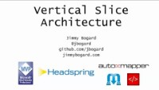
Before we get started
Jimmy Bogard has been blogging and presenting over this topic for years. Go check his stuff out.
https://jimmybogard.com/
https://www.youtube.com/watch?v=5kOzZz2vj2o

Slide 3
Software Architecture
The code structures that make up a software system and how those structures interact with each other.
A good architecture makes adding and modifying the software without introducing bugs easier.
It’s tough to get a good feel for if an architecture is good or bad until it’s too late.

Slide 4
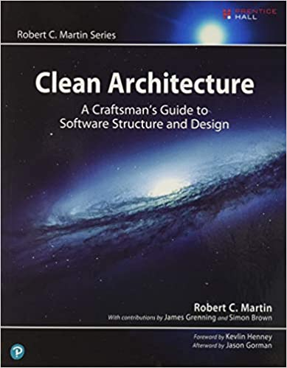
Clean Architecture

Slide 5
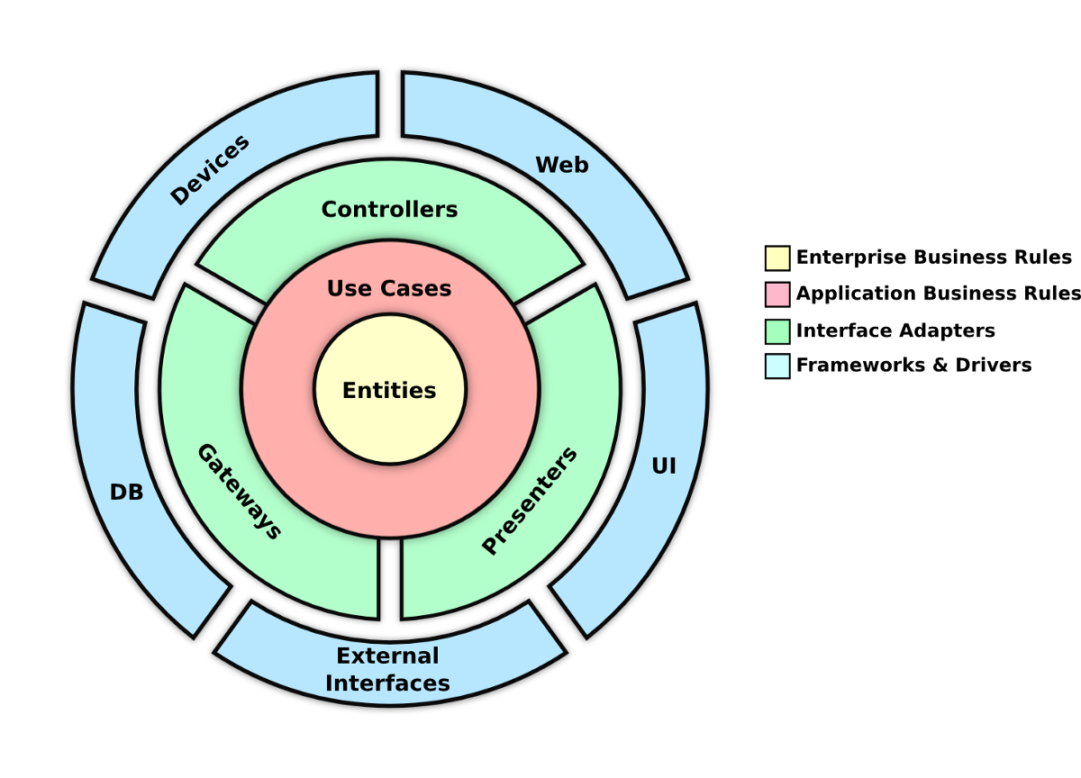
Clean Architecture
Notes:
Enterprise Business Rules: Business rules that would exist if the business ran on pen and paper.
Ex. Applying sales tax to an order, checking that an item is in stock
Application Business Rules: Business rules that exists because the work is being done with software
Ex. Data validation, check for valid email, valid dates…

Slide 6
Clean Architecture
UI | Client
Database
Controller | Presenter
Data Access
Use Case
Entities

Slide 7
Clean Architecture
View | Console Client | Blazor Component
EF | Data Access
Controller
Repository
Service
Domain | Core | Models
Notes:
Enterprise Business Rules: Business rules that would exist if the business ran on pen and paper.
Ex.

Slide 8
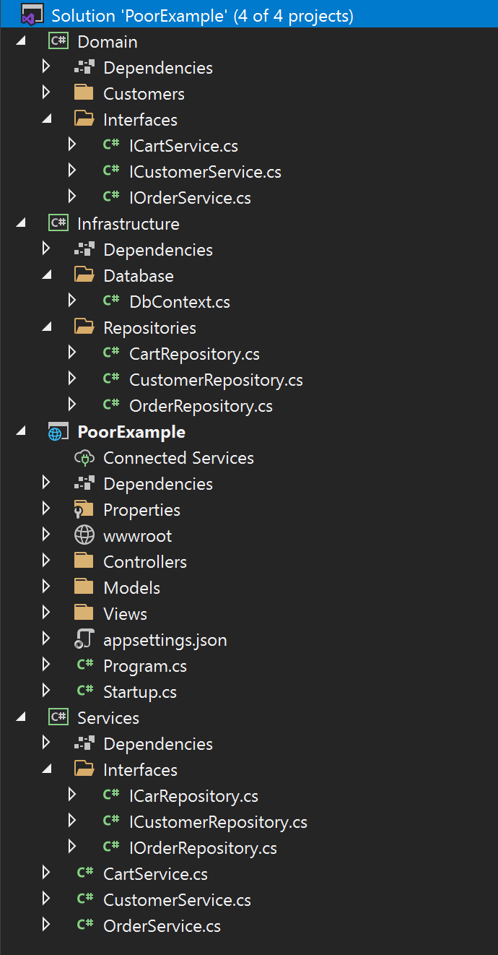
Clean Architecture
We can achieve this inversion of dependencies by having the inner layers interact with an interface that’s implemented by the outer layers.
We can enforce that dependencies flow the right direction by using class libraries.

Slide 9
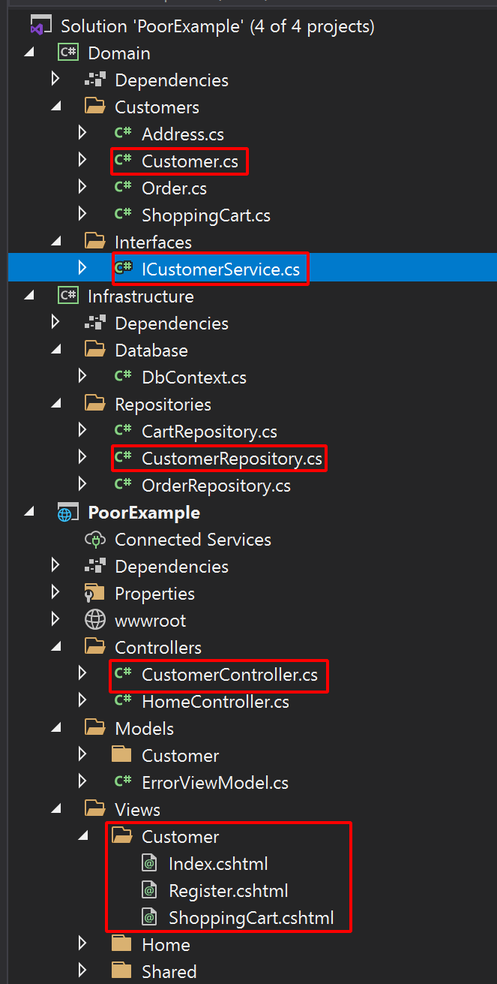
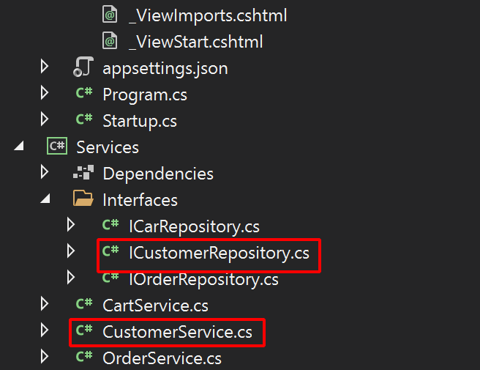
Clean Architecture
The downside is when adding features there are a lot of places to make changes.

Slide 10
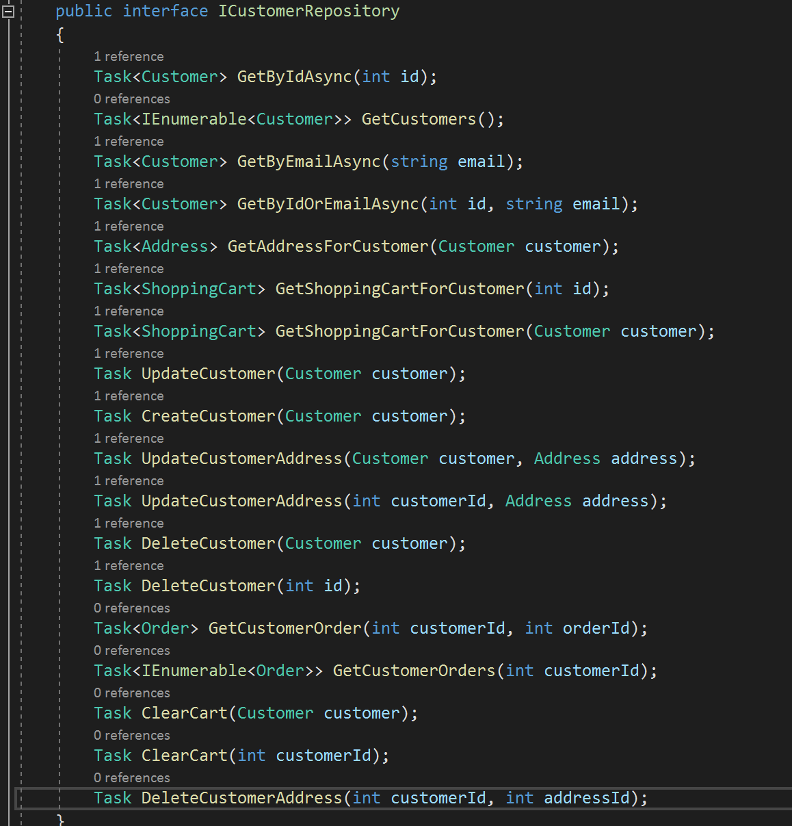
Clean Architecture
It’s easy to let classes get large.

Slide 11
Vertical Architecture
UI | Database
Controller | Data Access
Add Product to Catalog
Register Customer
Send Return Label
Create Order
Use Case
Entities
Notes:
Within out application we have these vertical swim lanes, or slices where each feature is made up of a small slice of each layer.
Vertical architecture asks, “What if instead of focusing on arranging our code into these horizontal layers, we try to arrange it into vertical layers.”

Slide 12
Vertical Architecture
Add Address
Remove Product
Add Product to Catalog
Register Customer
Send Return Label
Create Order
Notes:
We can arrange our code vertically, but at some point we’ll need to add in some horizontal layers

Slide 13
Vertical Architecture
Data Layer / ORM
Data Layer / Micro ORM
Order Repo
Customer Repo
Shipping gateway
Add Address
Remove Product
Add Product to Catalog
Register Customer
Send Return Label
Create Order
Use Case
Use Case
Use Case
Use Case
Use Case
Use Case
Entity
Entity
Notes:
We can arrange our code vertically, but at some point we’ll need to add in some horizontal layers.
There will be some point in which we want to reuse code.
We’ll also need to introduce some abstractions at various layers if we’re every going to write unit tests.

Slide 14
Vertical Architecture
Favor keeping code related to a single feature near each other. Only introduce abstractions as you need to.
Each feature should be (mostly) decoupled from all other features.
Once each feature is decoupled follow PDD (Pain driven development).
Notes:
Don’t go creating repositories and services just because you’re following clean architecture. Interact with your database straight from you use case code. Toss all your business logic in the same spot too. Rely on your refactoring expertise to dictate when and where you add abstraction. Prefer to tightly couple vertical slices to over loosely coupling horizontal tiers.
Each feature should be (mostly) decoupled from all other features. I say mostly because there will be times when you should share classes and functionality between your features, but it’s important to understand that doing so is a trade off.
Don’t prematurely refactor your code. Only refactor when dealing with the code gets painful. Evaluate, is the pain of dealing with this duplicate code/functionality more than the pain of dealing with an abstraction that’s coupled to both features?
Is the pain of testing the use-case as is less than the pain of writing and maintaining abstractions to make that piece of code testable.

Slide 15
Trade-offs
Less strict. Lets the developer best decide how to add abstractions for each scenario.
Adding new features means writing new code. All that new code goes in one place.
Your architecture mimics the software, “screaming architecture”.
Notes:
The developer for each feature decides how best to add abstractions without creating unnecessary pain.
Because features are decoupled from each other adding a new feature means you’re mostly writing new code as opposed to adding to already existing classes. It’s easier for new developers to feel comfortable adding functionality without introducing bugs. Modifying code for one features has a smaller chance of changing the behavior of another feature.
Finding where the code for a feature is easier to developers unfamiliar with the project.
Ex. Let’s say you want to add a change to the customer registration feature. Having that behavior encapsulated within the RegisterCustomerHandler is a lot more obvious than knowing that registration happens within the CustomerService.

Slide 16
Trade-offs
Less strict. Puts a lot of faith in the developer understanding how to identify and refactor code smells.
Less abstractions can make testing more difficult.
Projects can become large and contain many objects.
Notes:
The lack of rigid abstractions makes writing messy code easier and puts a lot of faith in the developer knowing how to identify code smells and refactor. Different areas of the application can end up using different levels of abstraction, which can make understanding the code more difficult.
Less abstractions can make testing more difficult. Integration tests may end up covering a larger portion of your code than unit tests. If you’re use case code is interacting directly with the database, you’ll have to stand up a database to test that code.
A few slides ago we saw how objects can become incredibly large following clean architecture. With vertical architecture we have many small objects and projects can grow very large and organizing all these files can become an issue.

Slide 17
Mediatr
https://github.com/jbogard/MediatR
“A simple, unambitious mediator implementation in .NET.”
Decouples business logic from the client code.
Notes:
A mediator is an object that encapsulates how a set of objects interact. Objects no longer communicate with each other, but rather through the mediator.

Slide 18
Where does Mediatr Fit in?
Input
Use Case
Output
Mediator

Slide 19
Where does Mediatr Fit in?
Request
Request Handler
Result
Notes:
Kind of like an in-memory event bus

Slide 20
Where does Mediatr Fit in?
Handles the routing of requests to request handlers
Offers a clean way to implement cross cutting concerns via PipelineBehaviors.
Takes care of registering all our request handlers with the IServiceProvider.
Notes:
The client tosses some data in an object and ships it off on the mediator.
The mediator along with the help of our DI container, is responsible for executing the right handler and injecting all the dependencies it needs,

Slide 21
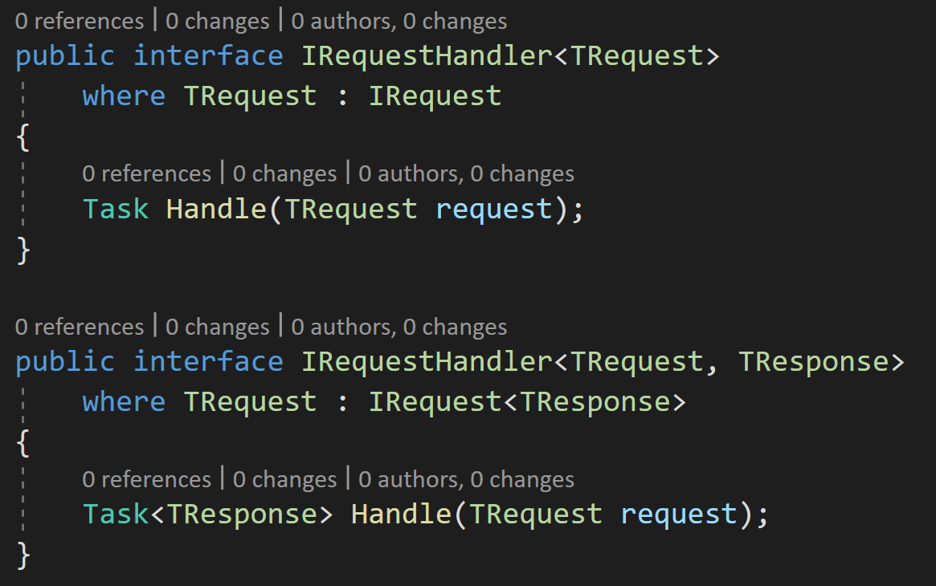
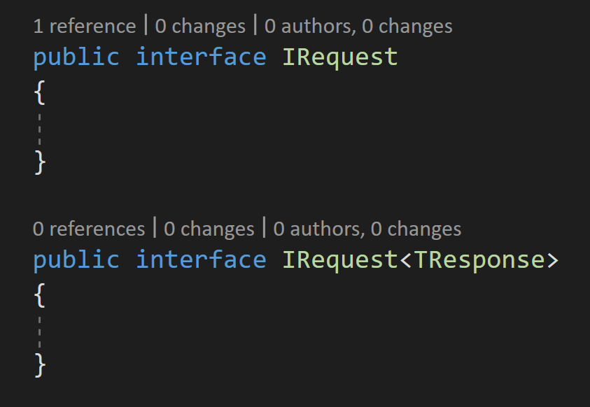
Requests and Request Handlers
Notes:
Requests implement the Irequest or Irequest<Tresponse> marker interface. There’s nothing to implement. A marker interface is used so mediatr can find the correct handler for each request.

Slide 22
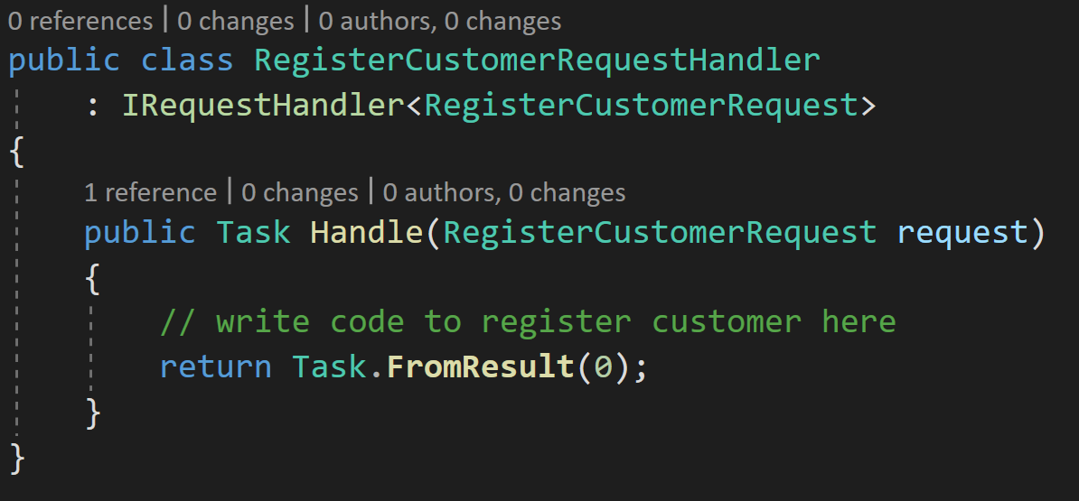
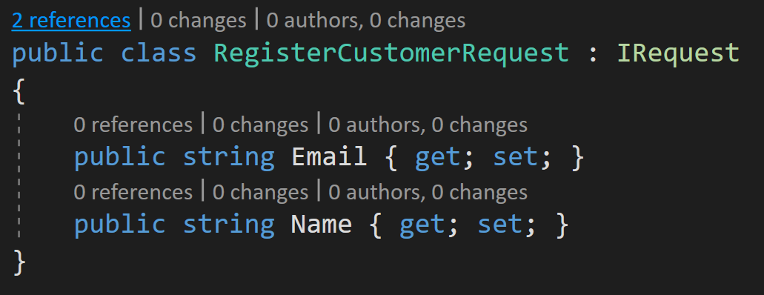
Requests and Request Handlers

Slide 23
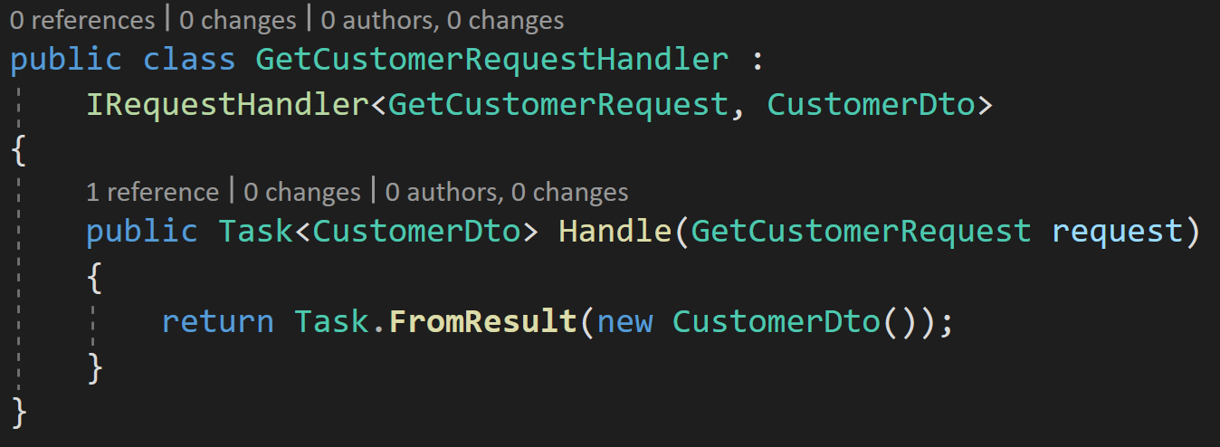
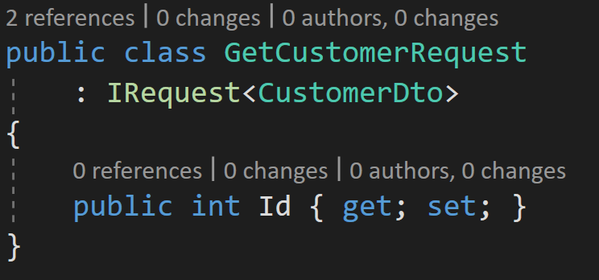
Requests and Request Handlers
Notes:
Requests implement the Irequest or Irequest<Tresponse> marker interface. There’s nothing to implement. A marker interface is used so mediatr can find and instantiate the class at runtime using reflection.

Slide 24
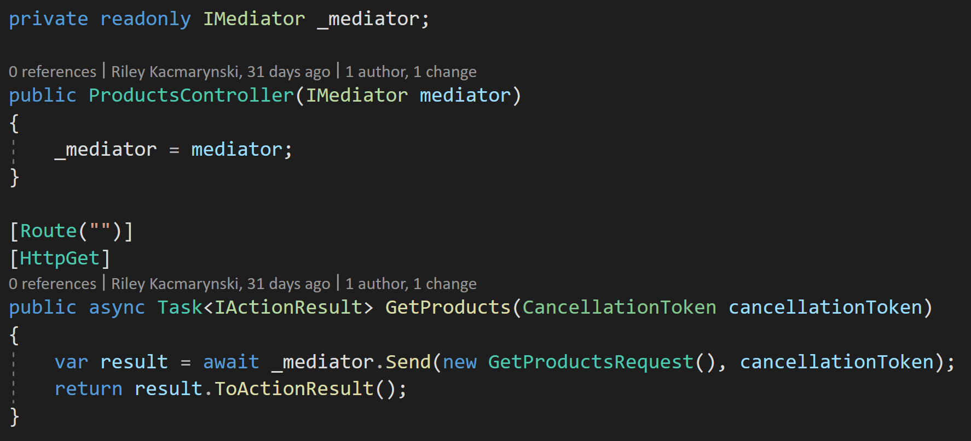
Sending the Request

Slide 25
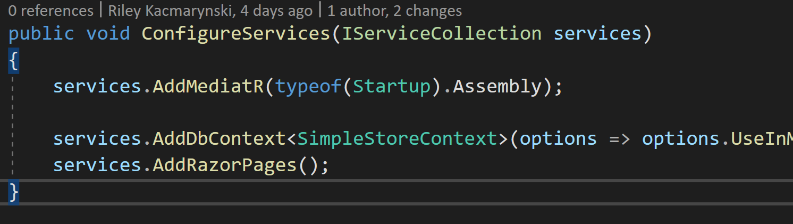
Adding to a Project

Slide 26
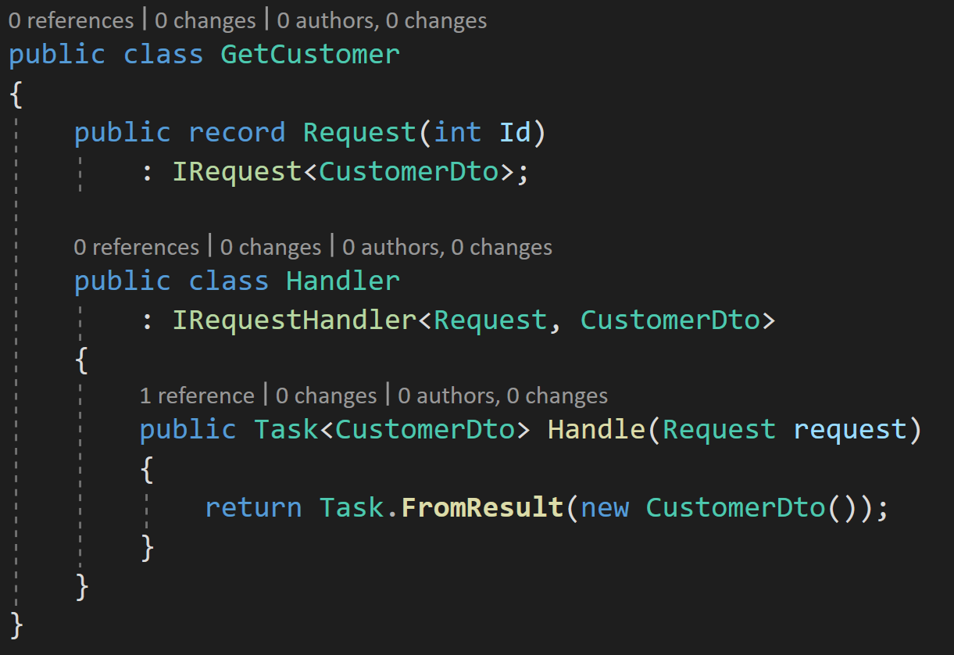
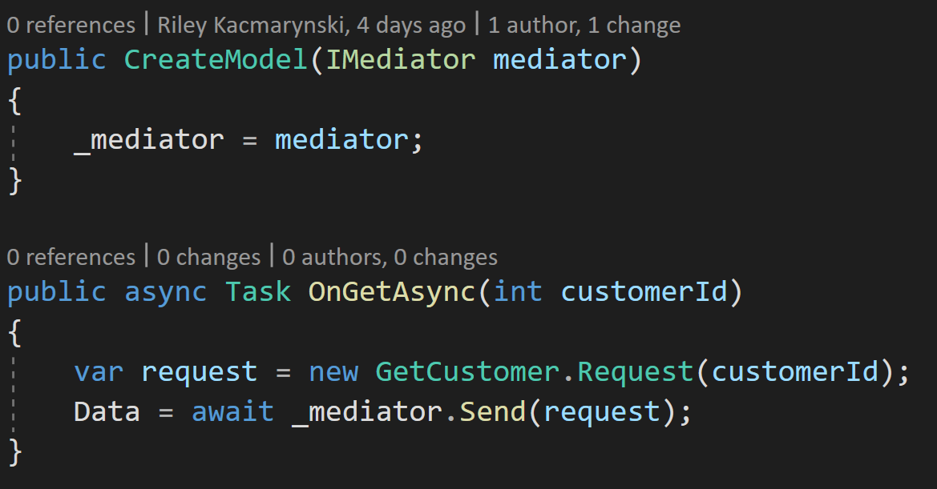
Nested classes

Slide 27
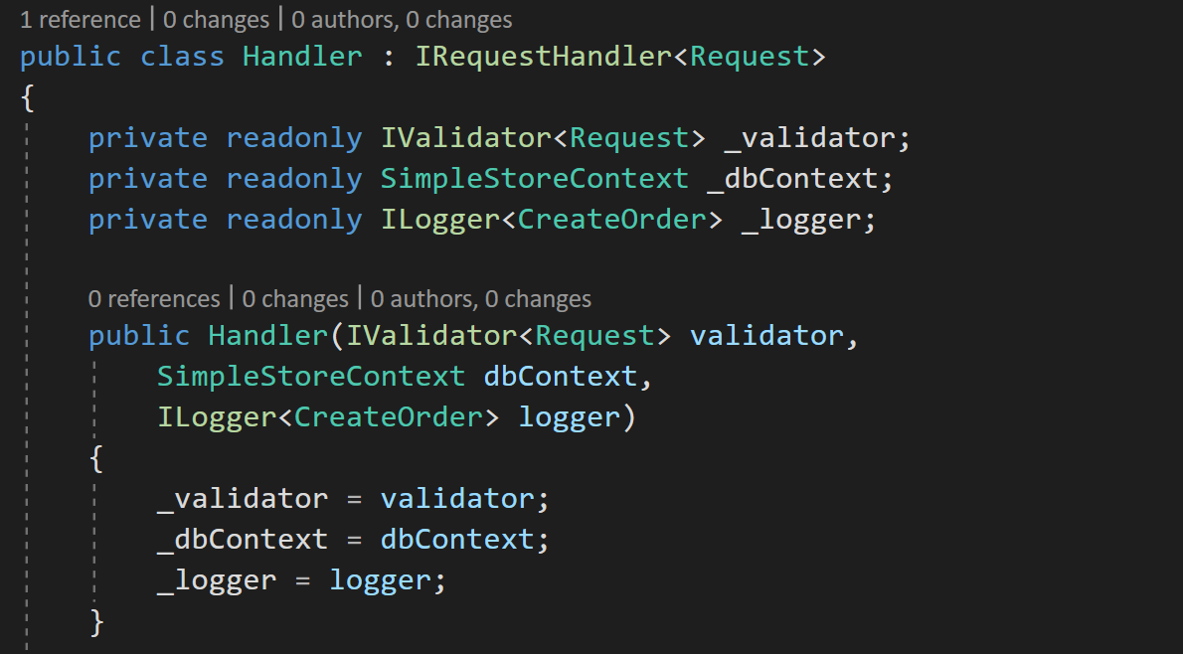
Handlers
Think of each handler as the entry point to a mini application.
Start by tossing all logic for a feature in that handler.
Refactor when it starts to look gross.
Notes:
You can inject any dependency registered with the service provider.
We’re trying to avoid over refactoring and adding unneeded complexity.

Slide 28
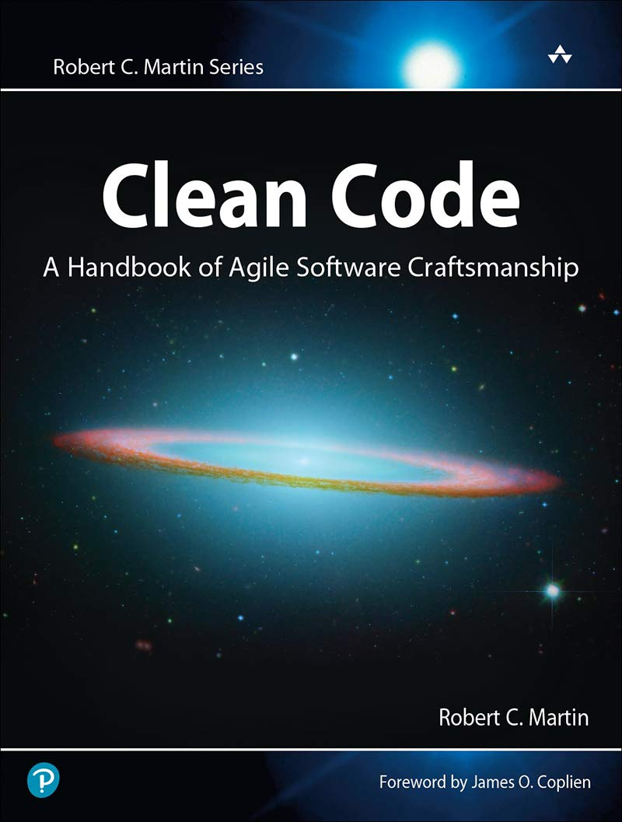
How do you know when it looks gross?
Notes:
You can inject any dependency registered with the service provider.

Slide 29
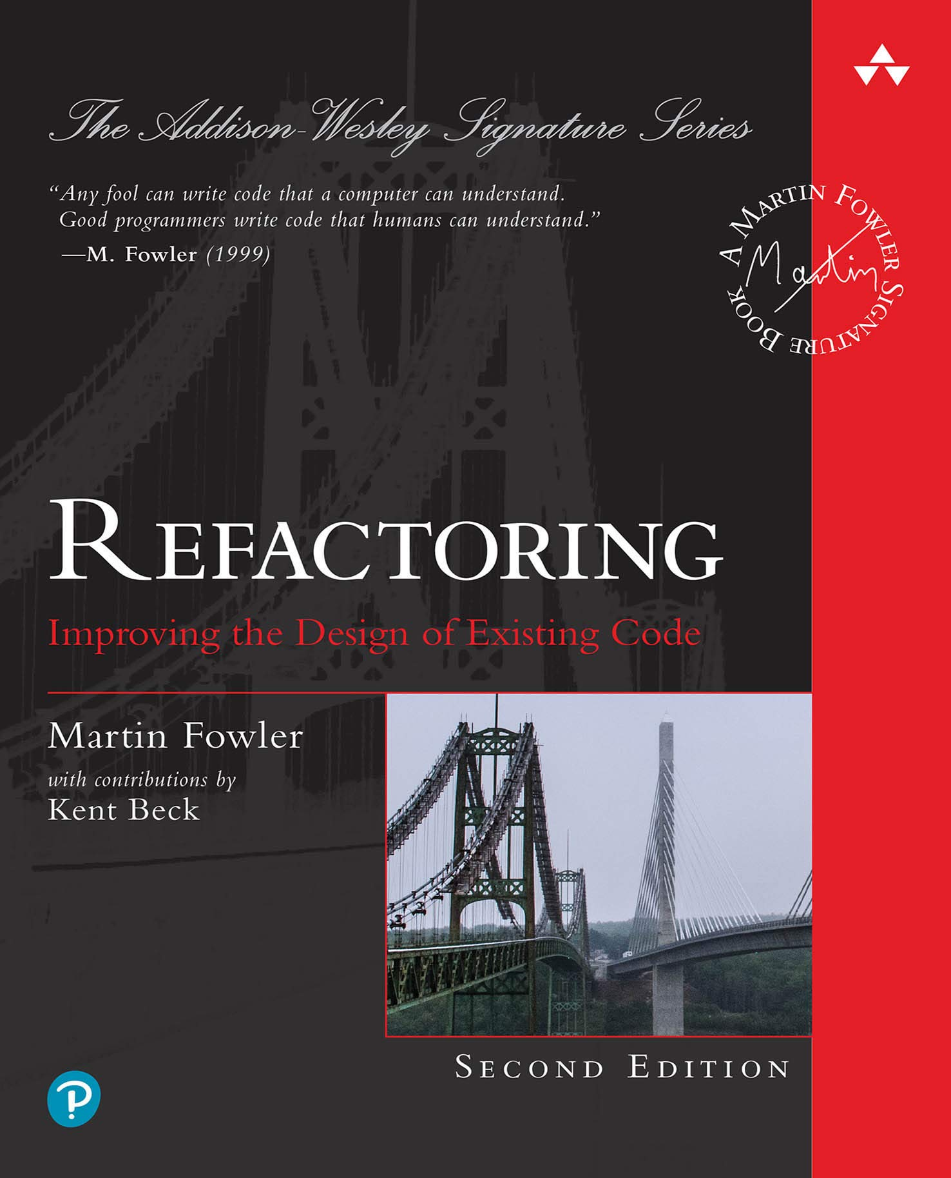
How do you know what to do with gross code?
Notes:
You can inject any dependency registered with the service provider.

Slide 30
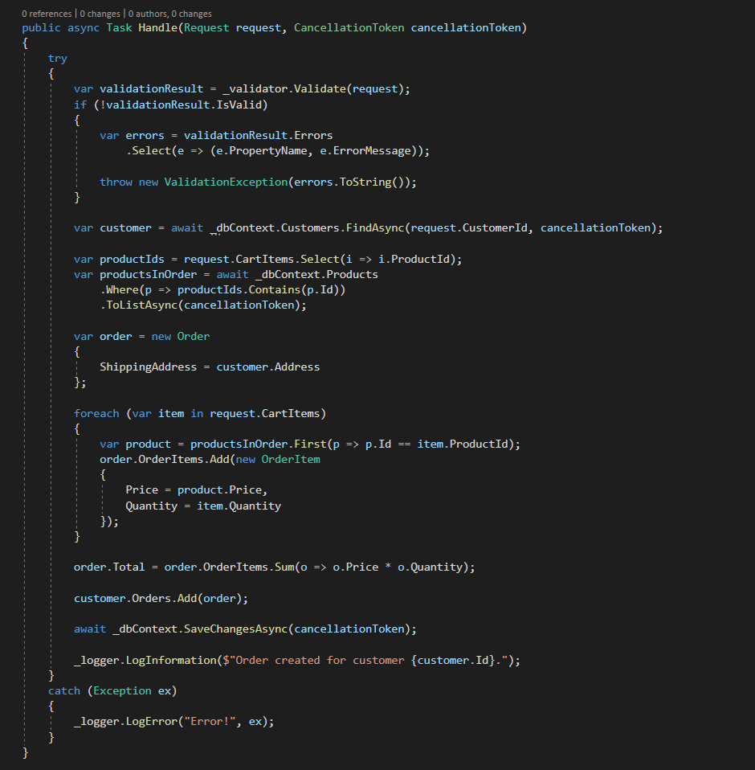
Example Time: Create Order
Notes:
What’s wrong here?
Getting tough to read. We’re over a screen height long, we’ve got a decent amount of nesting
We have different levels of concerns: business logic, logging, exception handling, validation
Validation and error handling code are going to
We’re reliant on a concrete dbcontext. We can’t unit test out business logic.

Slide 31
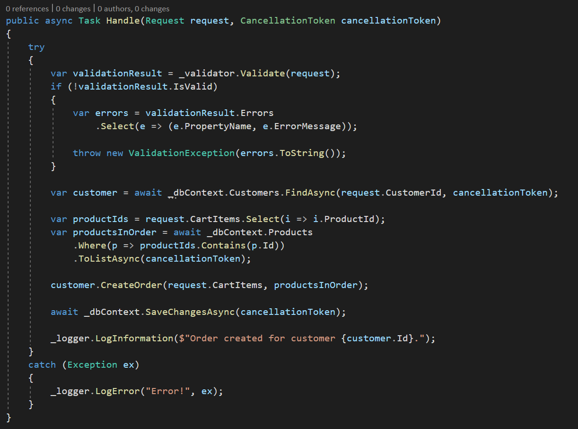
Example Time: Create Order
Notes:
Let’s start with the business logic, actually creating the order.
We can’t test it as is, what’s the easiest way we can refactor to make our business logic testable?
We can abstract the db access out behind an interface and fake out that interface, but that’s a lot work.
We could move the business logic into its own method, but then we’d have to make the method public to test it, and that’s smelly.
Let’s just create a new class, or move the functionality to an already existing class that’s testable.
STOP. We have to be aware that by moving this functionality out of the handler we are introducing coupling between this handler and any other handler that uses that class.
Our business logic is no longer in the handler, but that’s ok, it’s along with all the logic related to a customer and we’re aware of the tradeoffs.

Slide 32
Example Time: Create Order

Slide 33
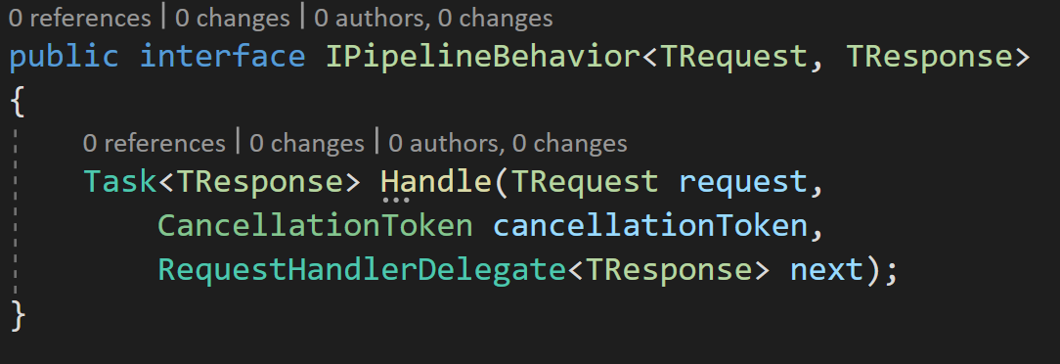
Pipeline Behaviors
Notes:
A pipeline behavior is a decorator around your request handlers.
Pipeline behaviors implement almost the same interface as a request.
The only difference is a pipeline behavior is passed a delegate that is either the next behavior in the pipeline or the final request handler.
It works almost identical to .NET Core middleware.
Pipeline Behaviors are registered with the service provider any other service.

Slide 34
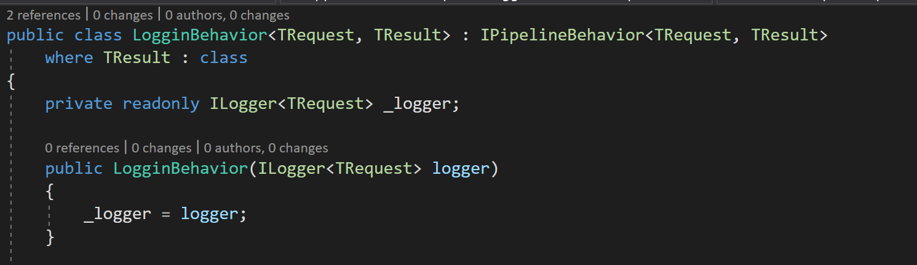
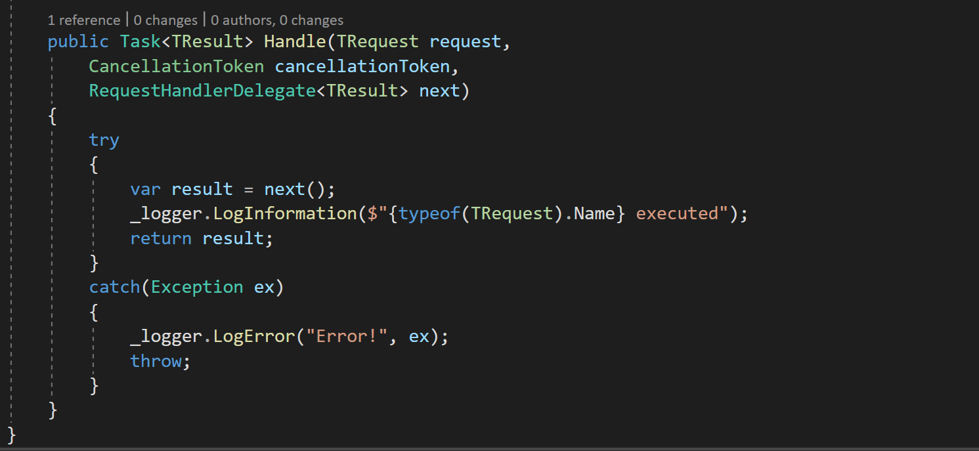
Example Time: Logging Behavior

Slide 35
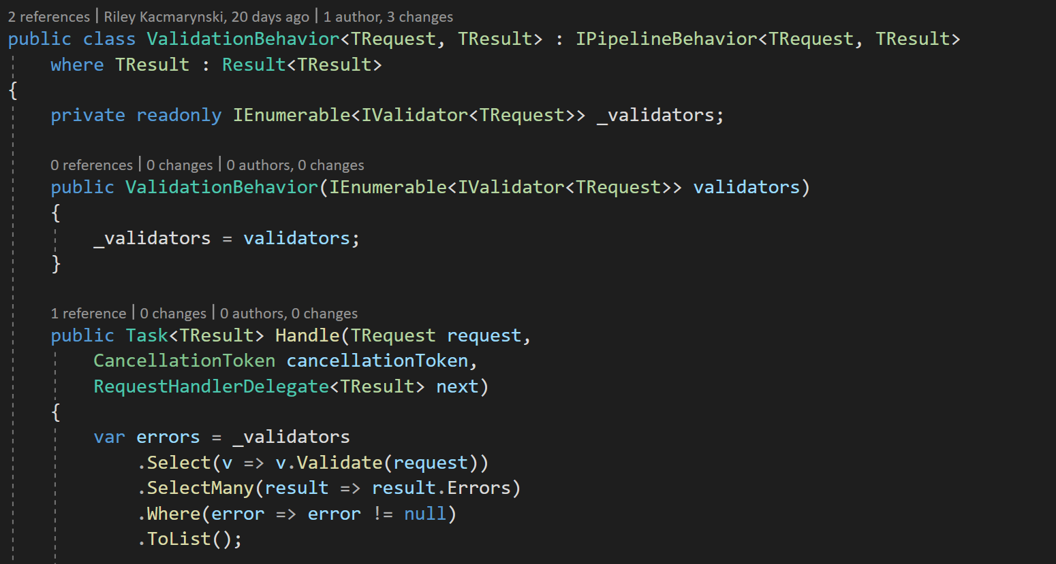
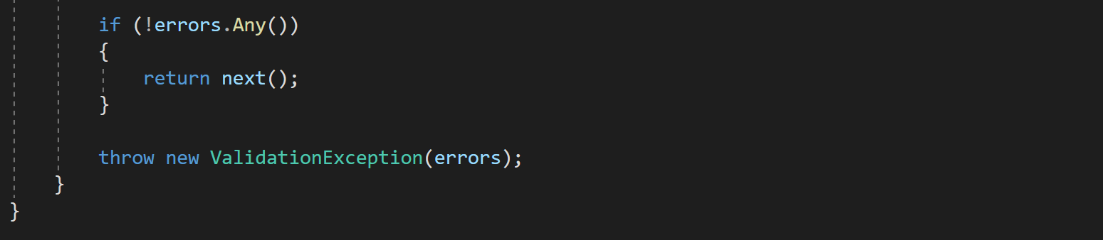
Example Time: Validation Behavior

Slide 36
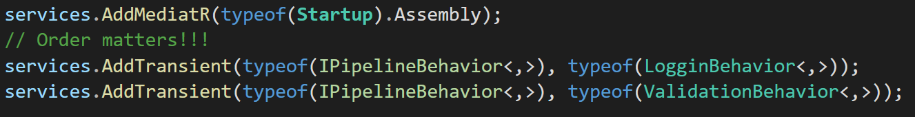
Example Time: Startup.cs

Slide 37
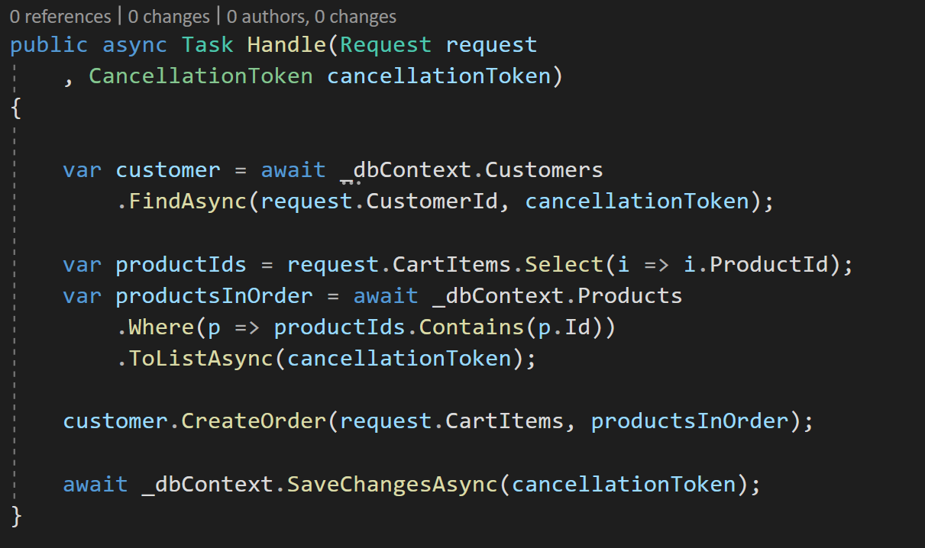
Example Time: Create Order
Notes:
From here if you wanted to cover the handler with a unit test you would have to create some sort of repository or data service.
This is only necessary for handler with somewhat complex business logic.
For simple handlers with simpler logic like querying data from a database maybe don’t introduce any abstractions.
For simple use cases covering the handler with an integration test might be good enough.

Slide 38
Testing
Request
Request Handler
Result
Pipeline Behaviors
Notes:
There are a couple different ways to test handlers.
You can use the mediator object to send the request through the entire pipeline. Closer to an integration test
You can create the handler on its own supplying its dependencies to the constructor and call the handle method. More like a unit test.

Slide 39
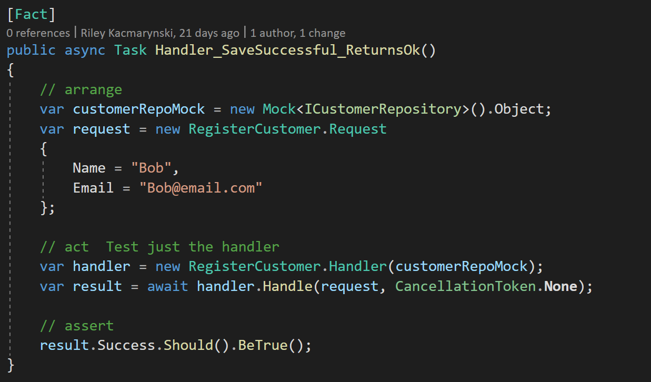
Unit Testing

Slide 40
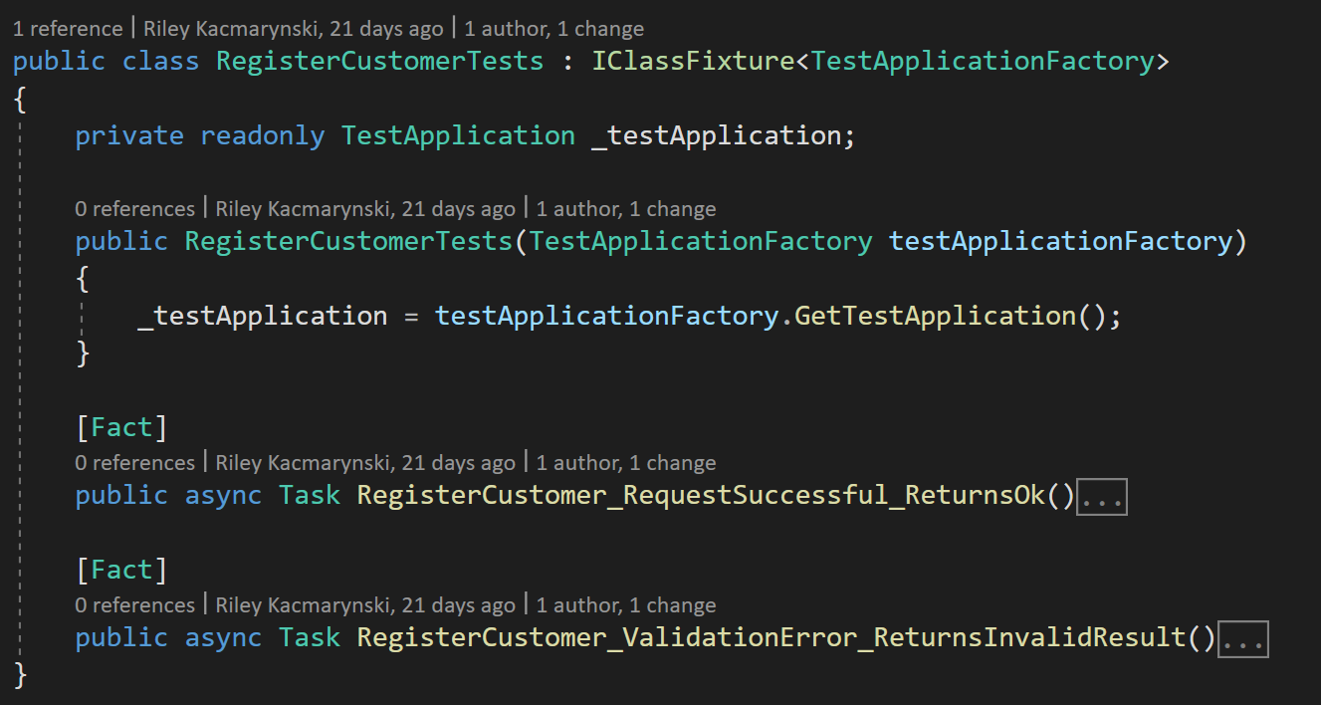
Integration Testing
Notes:
We can use Xunit to create a class fixture that uses our startup class to register the DI container.

Slide 41
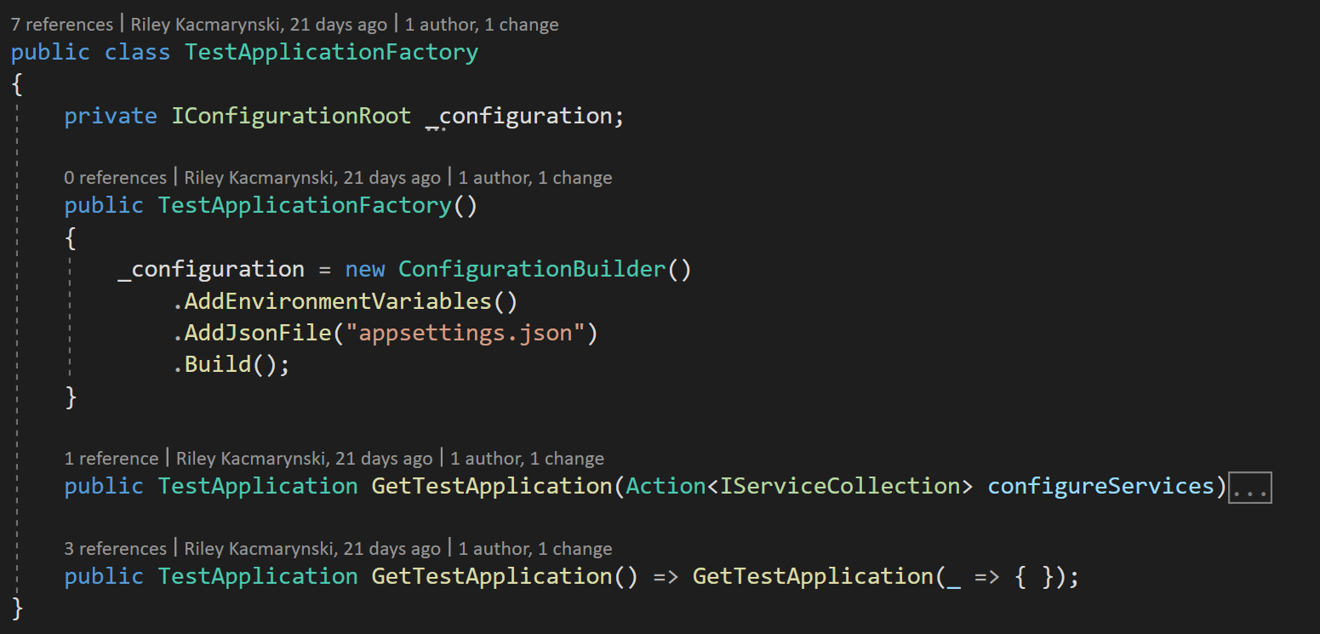
Integration Testing
Notes:
The factory sets up our configuration and uses the startup class in our application to register our services.

Slide 42
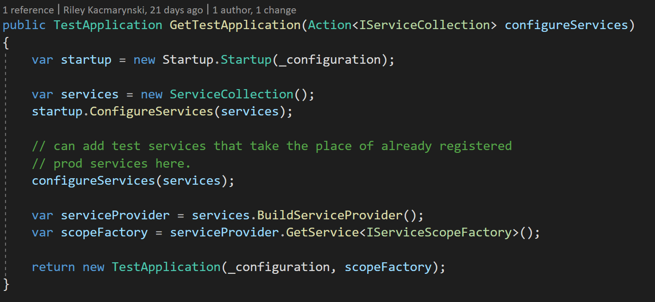
Integration Testing
Notes:
The scope factory is passed along so we can create a scope that will be used when resolving our scoped dependencies.
.NET Core web applications create a scope for us that is the lifetime of the request. Our tests aren’t running in the context of a .net core web app, so we have to manage the scope ourselves.

Slide 43
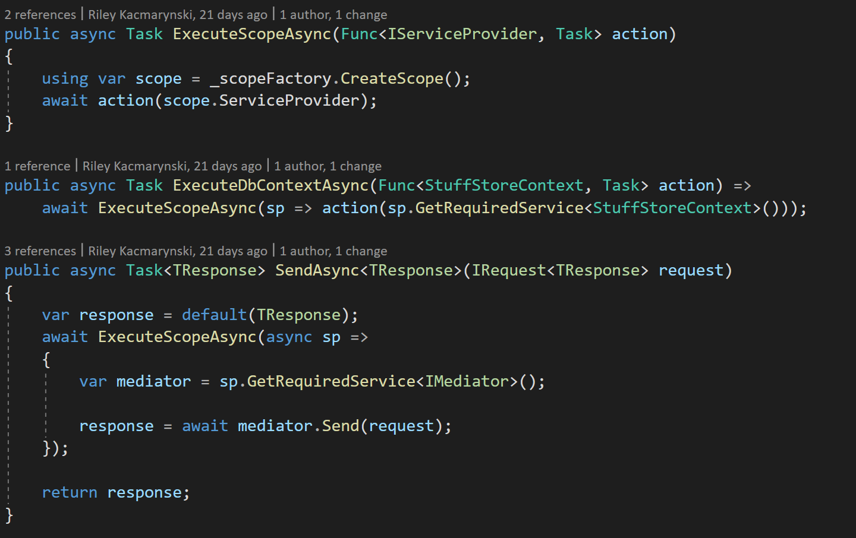
Integration Testing
Notes:
The scope factory is passed along so we can create a scope that will be used when resolving our scoped dependencies.
.NET Core web applications create a scope for us that is the lifetime of the request. Our tests aren’t running in the context of a .net core web app, so we have to manage the scope ourselves.

Slide 44
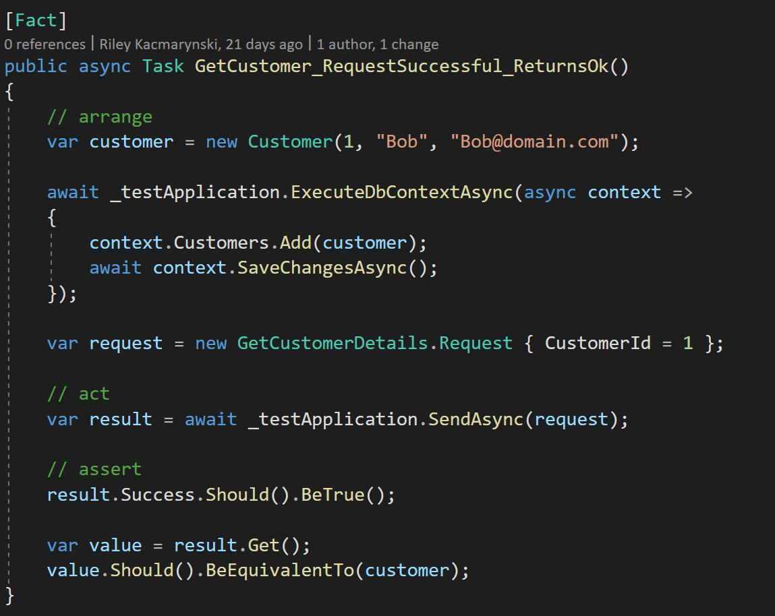
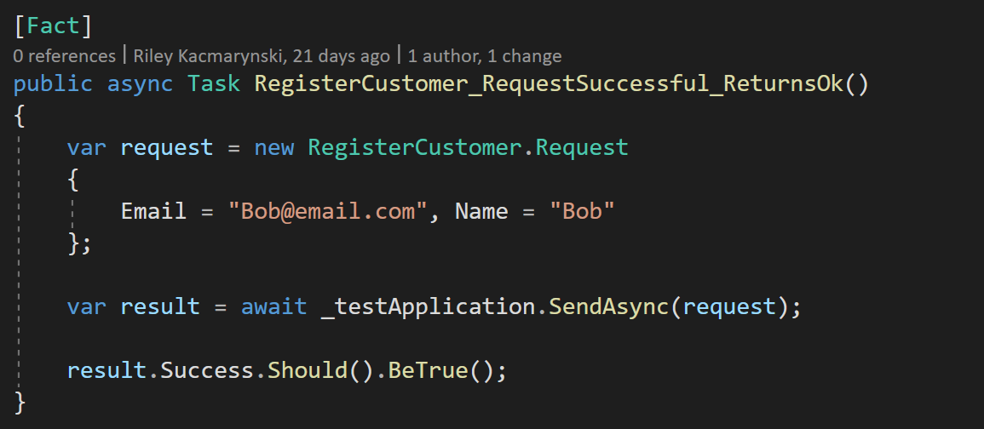
Integration Testing
Notes:
This makes our tests pretty simple.

Slide 45
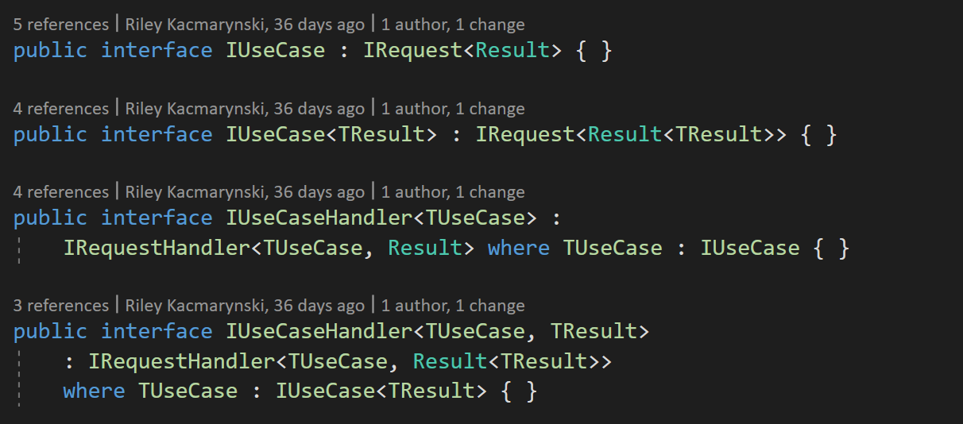
Advanced Scenarios
The marker interfaces used for requests and request handlers can be further constrained.
Notes:
Let’s say we want a to have a use case that always returns a generic result object.
We can enforce that by further constraining request and request handler interfaces.

Slide 46
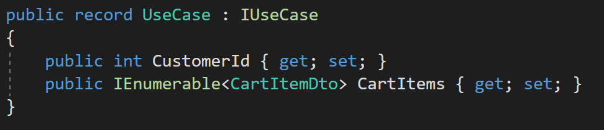
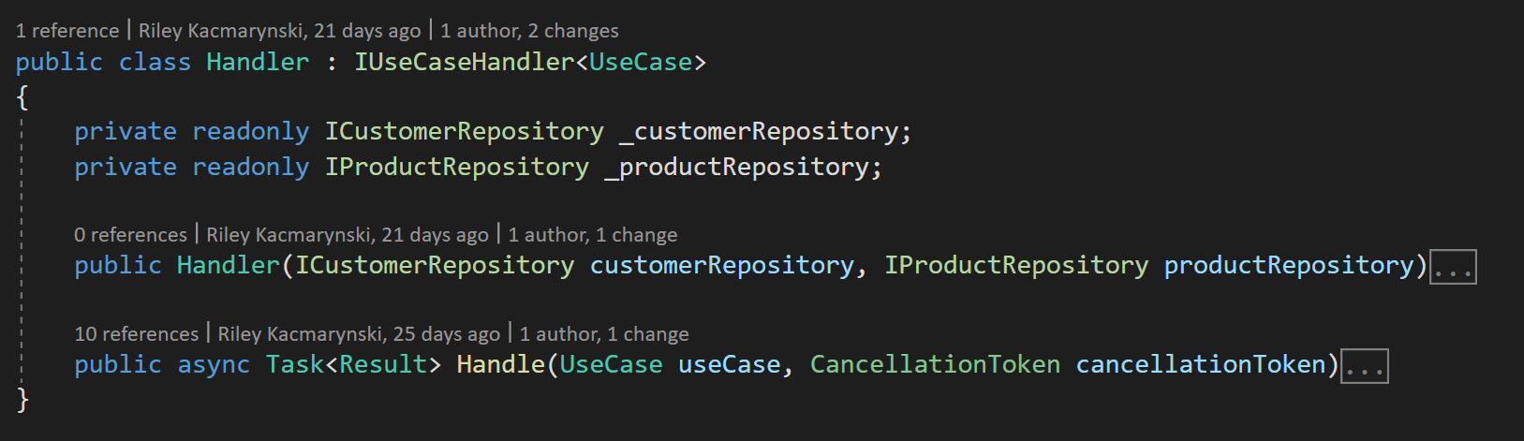
Advanced Scenarios
The use case doesn’t mention anything about the Result object, but the handler is still required to return one.
Notes:
Let’s say we want a to have a use case that always returns a generic result object.
We can enforce that by further constraining request and request handler interfaces.

Slide 47
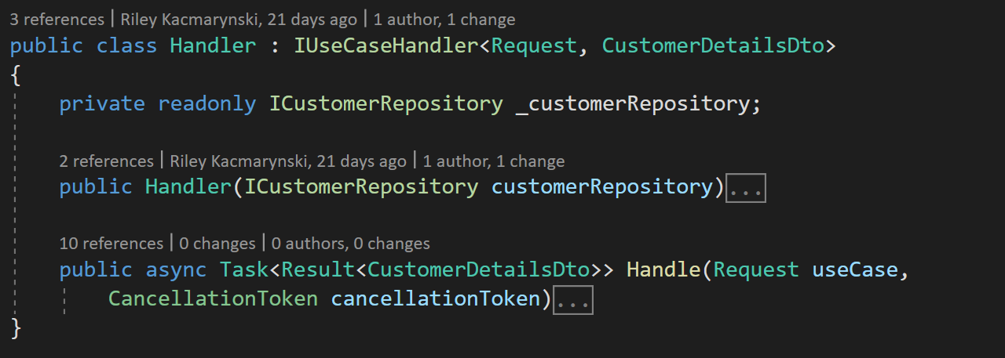
Advanced Scenarios
The use case doesn’t mention anything about the Result object, but the handler is still required to return one.
Notes:
Let’s say we want a to have a use case that always returns a generic result object.
We can enforce that by further constraining request and request handler interfaces.

